Slide 1
SITE CONTEXT
VILLAGE PWKY
AQUAMARINE RD
COLD SPRINGS
COLD SPRINGS ELEMENTARY SCHOOL | PUBLIC MEETING
COLD SPRINGS • WASHOE COUNTY SCHOOL DISTRICT
OCTOBER 2018

Slide 4
COLD SPRINGS ELEMENTARY SCHOOL PUBLIC MEETING
10.26.2018

Slide 5
PROJECT INTRODUCTION
Nancy Gomes Elementary School most overcrowded in Washoe County School District
Cold Springs Middle School is the only Middle school in Washoe County School District (5th - 8th grade)
COLD SPRINGS ELEMENTARY SCHOOL | PUBLIC MEETING
COLD SPRINGS WASHOE COUNTY SCHOOL DISTRICT
OCTOBER 2018
•

Slide 6
SITE ORIENTATION
MARINE R
3/4 mile
1/2 mile 1/4 mile
COLD SPRINGS ELEMENTARY SCHOOL | PUBLIC MEETING
COLD SPRINGS WASHOE COUNTY SCHOOL DISTRICT
OCTOBER 2018
•

Slide 7
LANDUSE
COLD SPRINGS ELEMENTARY SCHOOL | PUBLIC MEETING
COLD SPRINGS WASHOE COUNTY SCHOOL DISTRICT
OCTOBER 2018
•

Slide 8
QUESTION #4
How often do you typically visit the park? (select one answer)
Daily
A few times a week
Once a week
A few times a month
Once a month
A few times a year
I do not go to project site
COLD SPRINGS ELEMENTARY SCHOOL | PUBLIC MEETING
COLD SPRINGS WASHOE COUNTY SCHOOL DISTRICT
OCTOBER 2018
•

Slide 9
QUESTION #5
Where do you live?
(select one answer)
1/4 mile radius
1/2 mile radius
3/4 mile radius
Within Cold Springs area
None of the above
MARINE R
3/4 mile
1/2 mile
1/4 mile
COLD SPRINGS ELEMENTARY SCHOOL | PUBLIC MEETING
COLD SPRINGS WASHOE COUNTY SCHOOL DISTRICT
OCTOBER 2018
•

Slide 10
SITE PLAN ALTERNATIVES

Slide 11
INTRODUCTION TO INTIAL ALTERNATIVES
Brief orientation to project site and existing conditions
Each option explores a different arrangement of following elements:
Elementary School Placement
Park/open space
Developable area (commercial or residential)
Pedestrian nodes
Other opportunities
COLD SPRINGS ELEMENTARY SCHOOL | PUBLIC MEETING
COLD SPRINGS WASHOE COUNTY SCHOOL DISTRICT
OCTOBER 2018
•

Slide 12
EXISTING CONDITIONS
COLD SPRINGS ELEMENTARY SCHOOL | PUBLIC MEETING
COLD SPRINGS • WASHOE COUNTY SCHOOL DISTRICT OCTOBER 2018

Slide 13
COLD SPRINGS ELEMENTARY SCHOOL | PUBLIC MEETING
COLD SPRINGS • WASHOE COUNTY SCHOOL DISTRICT OCTOBER 2018

Slide 14
COLD SPRINGS ELEMENTARY SCHOOL | PUBLIC MEETING
COLD SPRINGS • WASHOE COUNTY SCHOOL DISTRICT OCTOBER 2018

Slide 15
COLD SPRINGS ELEMENTARY SCHOOL | PUBLIC MEETING
COLD SPRINGS • WASHOE COUNTY SCHOOL DISTRICT OCTOBER 2018

Slide 16
COLD SPRINGS ELEMENTARY SCHOOL | PUBLIC MEETING
COLD SPRINGS • WASHOE COUNTY SCHOOL DISTRICT OCTOBER 2018

Slide 17
COLD SPRINGS ELEMENTARY SCHOOL | PUBLIC MEETING
COLD SPRINGS • WASHOE COUNTY SCHOOL DISTRICT OCTOBER 2018

Slide 18
COLD SPRINGS ELEMENTARY SCHOOL | PUBLIC MEETING
COLD SPRINGS • WASHOE COUNTY SCHOOL DISTRICT OCTOBER 2018

Slide 19
QUESTION #7
Choose the BEST LOCATION for the Elementary School
OPTION 1
OPTION 2
Option 1
Option 2
None of the above
COLD SPRINGS ELEMENTARY SCHOOL | PUBLIC MEETING
COLD SPRINGS • WASHOE COUNTY SCHOOL DISTRICT
OCTOBER 2018

Slide 20
OPTION B
QUESTION #10
Choose the BEST PARK configuration
OPTION A
OCTOBER 2018
OPTION C
COLD SPRINGS ELEMENTARY SCHOOL | PUBLIC MEETING
COLD SPRINGS WASHOE COUNTY SCHOOL DISTRICT
•

Slide 21
OPTION E
QUESTION #11
Choose the BEST PARK configuration
OPTION D
OCTOBER 2018
OPTION F
Option A
Option B
Option C
Option D
Option E
Option F
None of the above
COLD SPRINGS ELEMENTARY SCHOOL | PUBLIC MEETING
COLD SPRINGS WASHOE COUNTY SCHOOL DISTRICT
•

Slide 22
PARK USES

Slide 23
USE OF THE PARKS
Passive Uses
Seating
Walking
Viewing
Social gathering
Art & cultural venues
Dog Park
COLD SPRINGS ELEMENTARY SCHOOL | PUBLIC MEETING
COLD SPRINGS WASHOE COUNTY SCHOOL DISTRICT
OCTOBER 2018
•

Slide 24
USE OF THE PARKS
Active Uses
Jogging / running
Biking
Sport uses
Playground / Nature Play
Water-related activities
Public & private events
COLD SPRINGS ELEMENTARY SCHOOL | PUBLIC MEETING
COLD SPRINGS WASHOE COUNTY SCHOOL DISTRICT
OCTOBER 2018
•

Slide 25
QUESTION #13
What do you usually do when visiting the park… (choose up to 3 answers)
Tot Lot / Splash pad
Walking / Jogging
Informal sports play
Organized sports play
Community Center
Go to school / drop off kids
Attend events, including sport games
Other - provide your comments on the card
COLD SPRINGS ELEMENTARY SCHOOL | PUBLIC MEETING
COLD SPRINGS WASHOE COUNTY SCHOOL DISTRICT
OCTOBER 2018
•

Slide 26
QUESTION #14
How often do you typically visit the park?
(select one answer)
Daily
A few times a week
Once a week
Once a month
A few times a year
I do not visit the park
COLD SPRINGS ELEMENTARY SCHOOL | PUBLIC MEETING
COLD SPRINGS WASHOE COUNTY SCHOOL DISTRICT
OCTOBER 2018
•

Slide 27
QUESTION #15
Which passive programs do you think are currently missing? (select all that apply)
Seating
Walking
Gathering and viewing space
Art and cultural venues
Dog Park
Other - please write on your comment card
COLD SPRINGS ELEMENTARY SCHOOL | PUBLIC MEETING
COLD SPRINGS WASHOE COUNTY SCHOOL DISTRICT
OCTOBER 2018
•

Slide 28
QUESTION #16
Which active programs do you think are currently missing? (select all that apply)
Jogging / running
Biking
Sport uses
Playground
Public & private events
Other - please write on your comment card
COLD SPRINGS ELEMENTARY SCHOOL | PUBLIC MEETING
COLD SPRINGS WASHOE COUNTY SCHOOL DISTRICT
OCTOBER 2018
•

Slide 29
QUESTION #17
What do you like about the park? (choose up to 3 answers)
Great gathering spaces
Well-maintained
Within walking distance
Clear signage
Accessible
Safe
Other – please write comments on your card
COLD SPRINGS ELEMENTARY SCHOOL | PUBLIC MEETING
COLD SPRINGS WASHOE COUNTY SCHOOL DISTRICT
OCTOBER 2018
•

Slide 30
QUESTION #18
What could be most improved? (choose up to 3 answers)
Gathering spaces
Maintenance
Accessibility
Signage
Safety
Other – please write comments on your card
COLD SPRINGS ELEMENTARY SCHOOL | PUBLIC MEETING
COLD SPRINGS WASHOE COUNTY SCHOOL DISTRICT
OCTOBER 2018
•

Slide 31
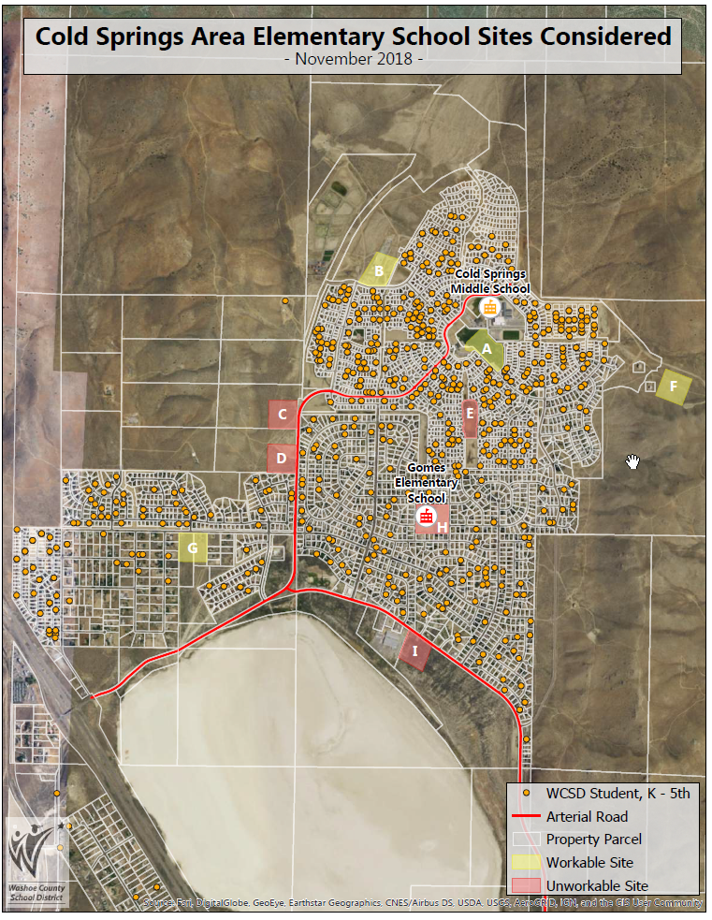

Slide 32
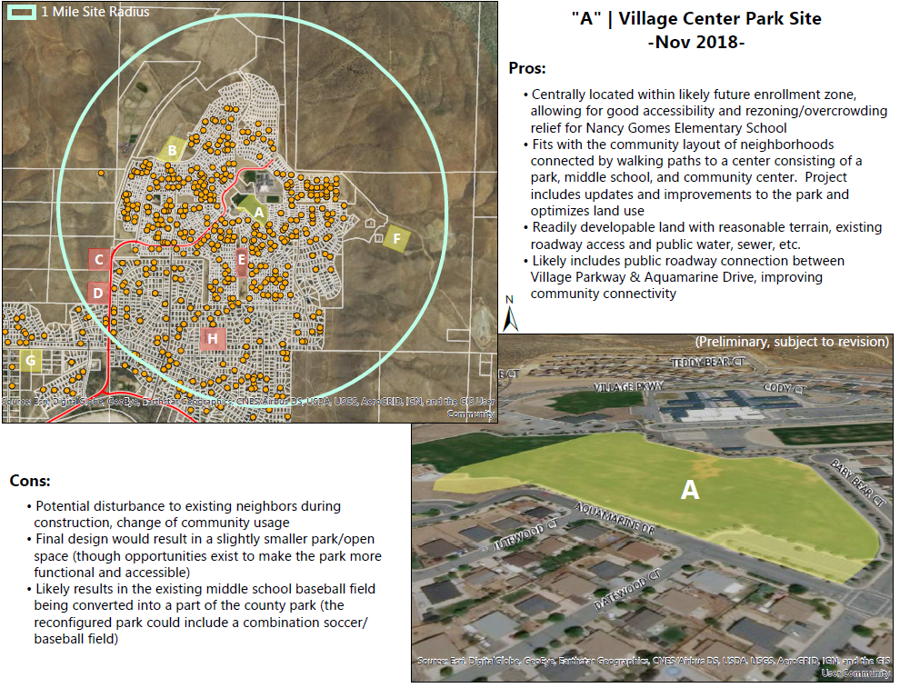

Slide 33
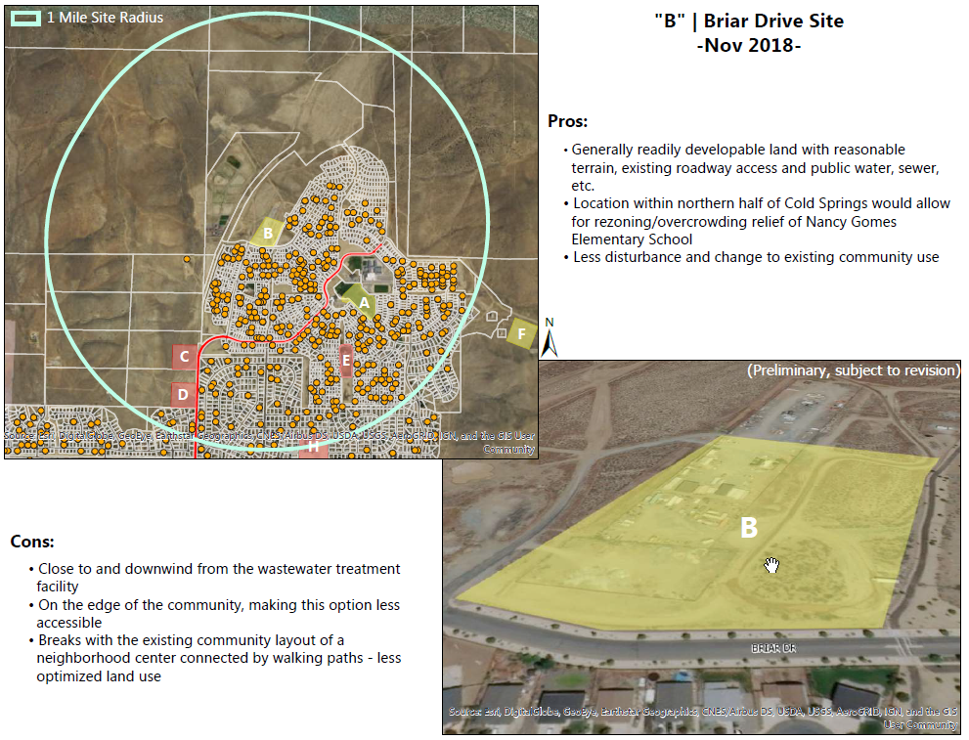

Slide 34
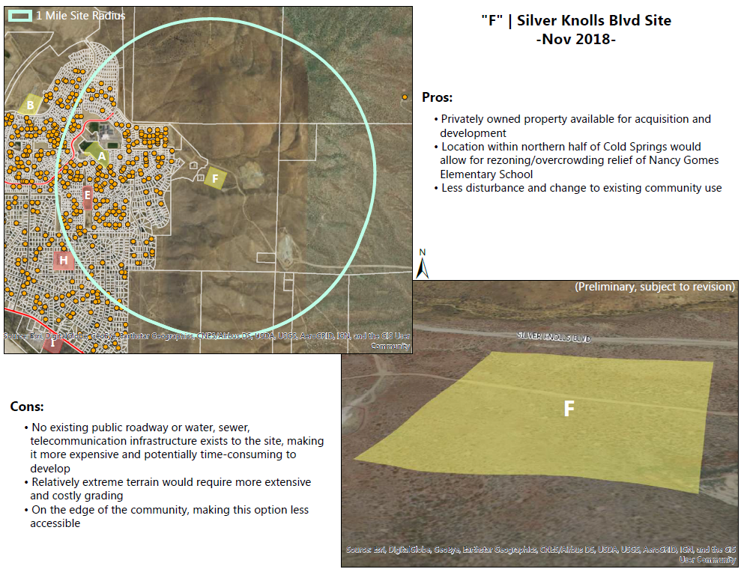

Slide 35
